Slide 1


Workforce Intelligence Network
Labor Market
Quarterly Reports
MEDC Region 9 Q1 2014 Expanded Report

Slide 2
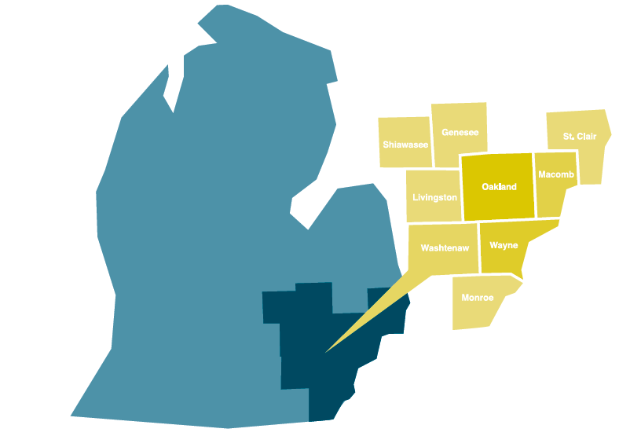
HELPING EMPLOYERS FIND THE TALENT THEY NEED FOR SUCCESS
EMPLOYER STRATEGIES
Information technology
Health care
Advanced manufacturing
Retail & hospitality
AWARENESS
Process improvement
Exemplary practices
Career support
Administrative change
Legislative change
DATA
Real-time
Traditional LMI
Original research
Forecasting
WIN Board
Community Colleges
Henry Ford Community College
Oakland Community College
Macomb Community College
Monroe County Community College
Mott Community College
Schoolcraft College
St. Clair County Community College
Washtenaw Community College
Wayne County Community
College District
Michigan Works! Agencies
Livingston County Michigan Works! Agency
Detroit Employment Solutions Corporation
Genesee-Shiawassee Michigan Works!
Macomb – St. Clair Michigan Works! Agency & Workforce Development Board
Oakland County Michigan Works! Agency
Southeast Michigan Community Alliance
Washtenaw County Michigan Works! Agency
WIN is funded through a grant from the New Economy Initiative for Southeast Michigan.

Slide 3

Goals
Branding and Marketing: Attract and retain top talent and industry
partners to the region through consistent branding and marketing
techniques presenting Southeast Michigan as both a technology and
innovation hub experiencing sustained growth and a great place to live
and work, while also highlighting the diverse companies engaged in
this effort.
Identifying Needs: Thoroughly explore and understand the regional
technology industry to identify talent needs to develop strategies and
encourage solutions that support short- and long-term national
Competitiveness
Networking: Support area technology firms by providing a network of
industry peers, potential partners, suppliers, and customers, as well as
direct access to workforce development partners, community based
organizations, higher education institutions, economic developers, and
other regional stakeholders to collectively and effectively address
industry-identified projects and challenges

Slide 4




Working Together, Preparing For Growth
Automotive manufacturing companies, educational institutions, and the workforce development system work together through the Michigan Academy for Green Mobility Alliance (MAGMA) to ensure the automotive industry has the engineering and technical talent needed to support hybrid, electric, lightweight, alternative fuel, and other advanced vehicle technologies.

Slide 5



https://ssgresearch.com/WIN-SPARK

Slide 6
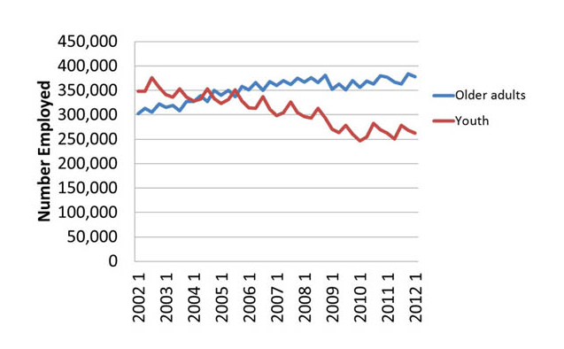

THIS IS WHAT IS HAPPENING NOW…
Notes:
In the last 10 years, employment for youth ages 14-24 fell by 24.5 percent (85,400 jobs) while employment for older workers age 55+ climbed 25.2 percent (76,100)—an almost perfect inverse relationship. In fact, older workers compose the only age group that saw an employment increase during the last recession while, at 30 percent, metro-Detroit's youth unemployment rate is the highest of any metro area in the country. As older workers hang on longer, we are leaving our young people behind. They simply are not getting the skills and experience that employers want these days (typically 1-4 years of experience) in the new workers they hire.

Slide 7
Talent Pipeline Data
Notes:
New graduates cannot possibly fill all of the open positions. Demand is between 2.5 times higher (healthcare) and 15 times higher (IT) than the need.
FYI: H1B visas are given in IT jobs, engineering, and healthcare. 32% of overall demand is in three STEM clusters.

Slide 8
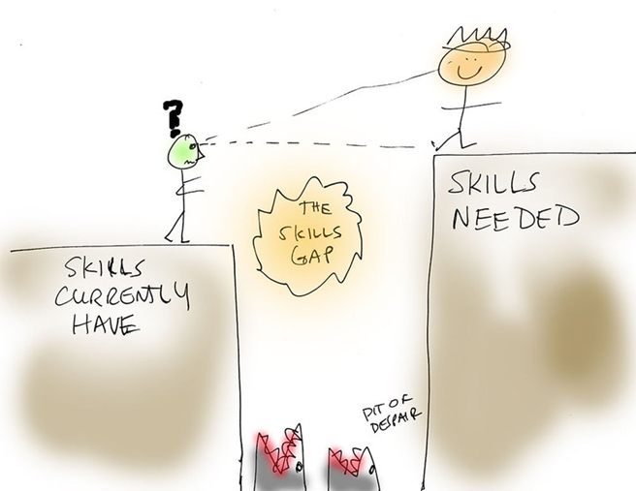
WHICH BRINGS US HERE

Slide 9
Labor Market and Demand overview
Section one

Slide 10
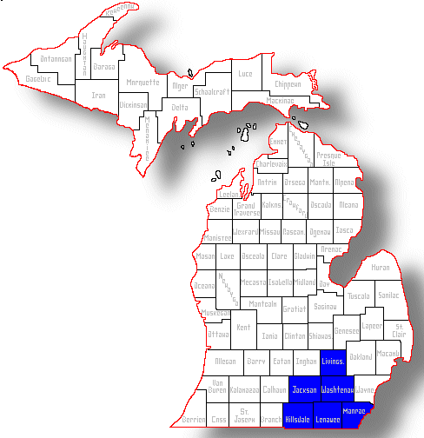
Geography
MEDC region 9 includes 6 counties, Lenawee, Jackson, Hillsdale, Livingston, Monroe, and Washtenaw.

Slide 11
Region 9 Job Q 1 2014
Employment by County

Slide 13
Top 20 jobs in demand (Jan-Mar 2014)
The most frequently posted jobs in MEDC Region 9 are drivers for heavy and tractor-trailer trucks, retail salespersons, registered nurses, sales representatives for wholesale goods, and customer service representatives. Retail and hospitality cluster jobs dominate this region’s job postings.

Slide 14
Top 5 Job Postings by County
Hillsdale
Heavy And Tractor-Trailer Truck Drivers
Retail Salespersons
First-Line Supervisors Of Retail Sales Workers
Maintenance And Repair Workers, General
Janitors And Cleaners, Except Maids And Housekeeping Cleaners
Jackson
Retail Salespersons
Heavy And Tractor-Trailer Truck Drivers
Maintenance And Repair Workers, General
Customer Service Representatives
First-Line Supervisors Of Retail Sales Workers
Lenawee
Heavy And Tractor-Trailer Truck Drivers
Retail Salespersons
Customer Service Representatives
Registered Nurses
First-Line Supervisors Of Food Preparation And Serving Workers
Livingston
Retail Salespersons
First-Line Supervisors Of Retail Sales Workers
Customer Service Representatives
Laborers And Freight, Stock, And Material Movers, Hand
Sales Representatives, Wholesale And Manufacturing, Except Technical And Scientific Products
Washtenaw
Heavy And Tractor-Trailer Truck Drivers
Registered Nurses
Sales Representatives, Wholesale And Manufacturing, Except Technical And Scientific Products
Software Developers, Applications
Retail Salespersons
Monroe
Heavy And Tractor-Trailer Truck Drivers
Retail Salespersons
Maintenance And Repair Workers, General
First-Line Supervisors Of Food Preparation And Serving Workers
Combined Food Preparation And Serving Workers, Including Fast Food

Slide 16
Employment and Labor Force Overview
 | 2010 Annual | 2011 Annual | 2012 Annual | 2013 Annual |  | Same Quarter 2012 | Same Quarter 2013 | Current Quarter 2014
Labor Force | 486,609 | 477,335 | 472,603 | 474,255 |  | 471,999 | 472,387 | 473,714
Employment | 431,376 | 428,687 | 433,163 | 438,655 |  | 429,897 | 435,339 | 438,415
Unemploy-ment | 55,233 | 48,840 | 39,440 | 35,600 |  | 42,102 | 37,048 | 35,299
Unemploy-ment Rate | 11.4% | 10.2% | 8.3% | 7.5% |  | 8.9% | 7.8% | 7.5%

Slide 17
Employment and the Labor Force
Employment in Region 9 has been slowly increasing since the trough in late 2010-early 2011. During Q1 2014, employment fell slightly but has grown compared to Q1 in 2013 (0.7% growth) and since Q1 2012 (2.0% growth). Q1 employment tends to be lower than other quarters during the year and 2014 seems to starting off on the same trend.
While employment has grown, the labor force has been stagnant. In Q1 2014, the labor force grew slightly, but overall trend is still relatively flat. The Q1 2014 labor force is 0.3% larger than it was in Q1 of 2013 and 0.4% larger than in Q1 of 2012. Slightly better than usual, but not enough for an upward trend.

Slide 18
Employer Demand (JAN-MAR 2014)
Employer online job postings in Region 9 increased by nearly 3,000 between Q4 2013 and Q1 2014. Historically, Q1 postings tend to be about 1,000 to 2,000 higher than Q4.
Postings in the region last peaked in Q3 2013 and have remained higher than all other quarters since 2011. If Q1 2014 is similar to Q1 in previous years than we should see an increase in postings next quarter as well.

Slide 19
Occupational clusters
Section two

Slide 20
Regional Demand Overview

Slide 21
Region 9 Job Q 1 2014
Share of Postings by County

Slide 22
Skilled trades
Section two

Slide 23
Advanced Manufacturing – skilled trades and technicians

Slide 24
Q1 2014 had an increase of more than 200 postings from Q4 2013 and increase of more than 250 from Q1 2013.
Postings for skilled trades and technicians jobs in Region 9 have stayed relatively stable despite several ups and downs from 2011 onward. Postings tended to peak in Q2 but 2013 balked that trend with postings peaking in Q3. If Q 1 2014 follows the trend from other 1st quarters we should see another increase in postings in Q2 2014.
Advanced Manufacturing – skilled trades and technicians

Slide 25
Regional Demand Overview: Skilled Trades & Technicians
Advanced Manufacturing – skilled trades and technicians

Slide 26
Skilled Trades and Technicians Top 10 Jobs Wages
ONET* Code | Occupation | Median Hourly Earnings | 10th Percentile Hourly Earnings | 90th Percentile Hourly Earnings | 2012 Mean Salary according to BLS
51-1011 | First-Line Supervisors Of Production And Operating Workers | $19.41 | $13.30 | $24.80 | $57,420
51-4011.00 | Computer-Controlled Machine Tool Operators, Metal And Plastic | $16.21 | $10.56 | $24.78 | $36,810
51-9199.00 | Production Workers, All Other | $21.06 | $14.96 | $27.27 | $30,380
51-9061.00 | Inspectors, Testers, Sorters, Samplers, And Weighers | $18.74 | $10.27 | $27.82 | $37,240
51-4121 | Welders, Cutters, And Welder Fitters | $20.01 | $9.33 | $31.87 | $38,410
51-4041.00 | Machinists | $17.48 | $11.66 | $34.39 | $40,860
51-4111.00 | Tool And Die Makers | $13.99 | $9.00 | $19.85 | $48,490
17-3023 | Electronics Engineering Technicians | $24.50 | $14.39 | $31.66 | $58,070
51-4031.00 | Cutting, Punching, And Press Machine Setters, Operators, And Tenders, Metal And Plastic | $22.50 | $12.84 | $32.53 | $31,090
51-9012.00 | Separating, Filtering, Clarifying, Precipitating, And Still Machine Setters, Operators, And Tenders | $19.12 | $10.87 | $29.95 | $40,340
Advanced Manufacturing – skilled trades and technicians

Slide 27
Skilled Trades and Technicians Top 10 Jobs Educational Requirements
Advanced Manufacturing – skilled trades and technicians

Slide 28
ENGINEERING & DESIGN
Section two

Slide 29
Advanced Manufacturing – engineers and designers

Slide 30
Postings for engineers and designers in Region 9 increased by about 80 since Q4 2013 and by almost 250 since Q1 2013.
Job postings for engineers and designers has been on the rise since Q1 2011. Q1 postings historically are not the peak of postings during the year, Q2 tends to be the high point. If this trend continues then we should see even higher demand in Q2 2014 than the current quarter.
Advanced Manufacturing – engineers and designers

Slide 31
Regional Demand Overview: Engineers & Designers
Advanced Manufacturing – engineers and designers

Slide 32
Engineers & Designers Top 10 Jobs Wages
ONET* Code | Occupation | Median Hourly Earnings | 10th Percentile Hourly Earnings | 90th Percentile Hourly Earnings | 2012 Mean Salary according to BLS
17-2071.00 | Electrical Engineers | $32.43 | $21.82 | $46.31 | $91,810
17-2141.00 | Mechanical Engineers | $46.70 | $28.08 | $71.93 | $84,770
17-2051.00 | Civil Engineers | $46.29 | $30.16 | $74.31 | $84,140
17-2199 | Manufacturing Engineers | $49.93 | $34.22 | $65.97 | $93,330
17-2112.00 | Industrial Engineers | $39.77 | $25.96 | $54.09 | $82,100
17-2081.00 | Environmental Engineers | $38.03 | $25.86 | $55.90 | $85,140
27-1021.00 | Commercial And Industrial Designers | $15.38 | $9.04 | $23.92 | $62,430
17-2199 | Validation Engineers | $49.93 | $34.22 | $65.97 | $93,330
17-2131.00 | Materials Engineers | $40.41 | $26.36 | $56.20 | $87,490
17-2199.00 | Engineers, All Other | $49.93 | $34.22 | $65.97 | $93,330
Advanced Manufacturing – engineers and designers

Slide 33
Engineers & Designers Top 10 Jobs Educational Requirements
Advanced Manufacturing – engineers and designers

Slide 34
Information technology
Section two

Slide 35
Information Technology

Slide 36
IT postings in Region 9 have not increased considerably since Q4 2013 but have increased by about 350 since Q1 2013.
IT postings in this region have not maintained a strong upward trend. There was a spike in Q3 2013 (this occurred in clusters and regions across the state), but the overall trend is relatively flat hovering around 1,200 since Q1 of 2011.
Information Technology

Slide 37
Regional Demand Overview: Information Technology
Information Technology

Slide 38
Information Technology Top 10 Jobs Wages
ONET* Code | Occupation | Median Hourly Earnings | 10th Percentile Hourly Earnings | 90th Percentile Hourly Earnings | 2012 Mean Salary according to BLS
15-1132.00 | Software Developers, Applications | $32.68 | $21.45 | $47.76 | $93,280
15-1151.00 | Computer User Support Specialists | $39.60 | $26.22 | $62.58 | $50,130
15-1121.00 | Computer Systems Analysts | $49.68 | $33.50 | $64.48 | $83,800
15-1131.00 | Computer Programmers | $40.00 | $24.68 | $59.09 | $78,260
15-1134.00 | Web Developers | $40.25 | $27.03 | $60.02 | $66,100
15-1142.00 | Network And Computer Systems Administrators | $36.51 | $21.54 | $54.20 | $76,320
15-1199 | Software Quality Assurance Engineers And Testers | $27.38 | $17.95 | $38.18 | $81,860
15-1141.00 | Database Administrators | $26.89 | $15.28 | $40.89 | $79,120
11-3021.00 | Computer And Information Systems Managers | $36.88 | $22.31 | $60.79 | $129,130
15-1199 | Computer Systems Engineers/Architects | $27.38 | $17.95 | $38.18 | $81,860
Information Technology

Slide 39
Information Technology Top 10 Jobs Educational Requirements
Information Technology

Slide 40
HEALTH CARE
Section two

Slide 41
Health Care

Slide 42
Health care job postings in Region 9 have increase by nearly 1,000 since Q1 2013 but only by about 120 since last quarter.
In general, the region has seen a very small increasing trend in health care job postings. Much of the 2011-2013 was flat until a spike in Q2 2013. While the postings have not reached this level in the past 2 quarters, the posting level has remained about 2,000, a marked increase from the average level of about 1,600 in previous years.
Health Care

Slide 43
Regional Demand Overview: Health Care
Health Care

Slide 44
Health Care Top 10 Jobs Wages
ONET* Code | Occupation | Median Hourly Earnings | 10th Percentile Hourly Earnings | 90th Percentile Hourly Earnings | 2012 Mean Salary according to BLS
29-1141.00 | Registered Nurses | $31.56 | $20.64 | $42.96 | $67,930
31-1014.00 | Nursing Assistants | $20.43 | $13.48 | $25.37 | $25,620
29-2061.00 | Licensed Practical And Licensed Vocational Nurses | $12.60 | $9.20 | $17.86 | $42,400
31-1011.00 | Home Health Aides | $23.38 | $18.06 | $27.30 | $21,830
31-9092.00 | Medical Assistants | $9.84 | $8.11 | $13.05 | $30,550
29-2071.00 | Medical Records And Health Information Technicians | $13.49 | $10.77 | $17.21 | $36,770
29-1171.00 | Nurse Practitioners | $30.40 | $21.55 | $41.08 | $91,450
29-1051.00 | Pharmacists | $26.86 | $19.48 | $33.94 | $114,950
29-1123.00 | Physical Therapists | $24.03 | $14.97 | $28.96 | $81,110
29-2052.00 | Pharmacy Technicians | $12.39 | $9.33 | $19.47 | $30,430
Health Care

Slide 45
Health Care Top 10 Jobs Educational Requirements
Health Care

Slide 46
Retail & hospitality
Section two

Slide 47
Retail & Hospitality

Slide 48
Retail and hospitality job postings dominate the clusters WIN researchers examine for Region 9. With nearly a 1,000 posting increase between Q4 2013 and Q1 2014 and almost 3,000 more in Q1 2014 than in Q1 2013, this is also the fastest growing cluster.
Similar to several other clusters, posting behavior was relatively flat throughout most of 2011-2013 with a huge surge in Q3 2013. Posting behavior has remained high and we project that postings will continue to increase.
Retail & Hospitality

Slide 49
Regional Demand Overview: Retail & Hospitality
Retail & Hospitality

Slide 50
Retail & Hospitality Top 10 Jobs Wages
ONET* Code | Occupation | Median Hourly Earnings | 10th Percentile Hourly Earnings | 90th Percentile Hourly Earnings | 2012 Mean Salary according to BLS
41-2031.00 | Retail Salespersons | $17.20 | $12.56 | $23.45 | $25,310
41-4012.00 | Sales Representatives, Wholesale And Manufacturing, Except Technical And Scientific Products | $19.38 | $12.85 | $28.60 | $64,300
43-4051.00 | Customer Service Representatives | $27.20 | $21.72 | $27.67 | $33,110
41-1011 | First-Line Supervisors Of Retail Sales Workers | $8.81 | $7.09 | $10.51 | $40,910
35-3021.00 | Combined Food Preparation And Serving Workers, Including Fast Food | $10.77 | $8.61 | $17.47 | $18,720
35-1012 | First-Line Supervisors Of Food Preparation And Serving Workers | $13.28 | $10.78 | $15.66 | $31,820
37-2011.00 | Janitors And Cleaners, Except Maids And Housekeeping Cleaners | $11.95 | $8.90 | $16.93 | $24,850
41-2011.00 | Cashiers | $23.75 | $14.86 | $38.15 | $20,370
11-2022.00 | Sales Managers | $50.07 | $31.10 | $81.60 | $119,980
37-2012.00 | Maids And Housekeeping Cleaners | $26.75 | $13.87 | $51.35 | $21,820
Retail & Hospitality

Slide 51
Retail & Hospitality Top 10 Jobs Educational Requirements
Retail & Hospitality

Slide 52
AGRICULTURE
Section two

Slide 53
Agriculture

Slide 54
Agriculture is a new cluster that WIN’s researchers have added to the Region 9 analysis. Posting behavior among employers does not seem to become a popular mechanism for finding workers yet (employment changes in agriculture are seasonal and exhibit much higher growth than the posting above indicate).
Despite the low level of postings, we do see growth in posting behavior with nearly 200 more postings in Q1 2014 than in Q4 2013 and more than double the postings in Q1 2014 than in Q1 2013.
Agriculture

Slide 55
Regional Demand Overview: Agriculture
Agriculture

Slide 56
Agriculture Top 10 Jobs Wages
ONET* Code | Occupation | Median Hourly Earnings | 10th Percentile Hourly Earnings | 90th Percentile Hourly Earnings | 2012 Mean Salary according to BLS
41-4011.00 | Sales Representatives, Wholesale And Manufacturing, Technical And Scientific Products | $12.28 | $9.57 | $17.15 | $85,690
39-9032.00 | Recreation Workers | $15.66 | $10.87 | $28.01 | $25,430
37-3011.00 | Landscaping And Groundskeeping Workers | $9.40 | $8.29 | $14.77 | $25,870
17-2081.00 | Environmental Engineers | $38.03 | $25.86 | $55.90 | $85,140
39-2021.00 | Nonfarm Animal Caretakers | $19.63 | $16.03 | $26.16 | $22,370
37-1012 | First-Line Supervisors Of Landscaping, Lawn Service, And Groundskeeping Workers | $20.09 | $12.46 | $29.06 | $45,100
19-2041.00 | Environmental Scientists And Specialists, Including Health | $29.73 | $18.08 | $48.07 | $68,970
29-9011.00 | Occupational Health And Safety Specialists | $20.94 | $12.37 | $30.67 | $67,960
51-3021.00 | Butchers And Meat Cutters | $18.72 | $11.20 | $27.75 | $30,000
25-9021.00 | Farm And Home Management Advisors | $16.02 | $11.14 | $25.45 | $48,730
Agriculture

Slide 57
Agriculture Top 10 Jobs Educational Requirements
Agriculture

Slide 58
Labor Market and Job Demand Summary
Employment in Region 9 has been slowly increasing since the trough in late 2010-early 2011. During Q1 2014, employment fell slightly but has grown compared to Q1 in 2013 (0.7% growth) and since Q1 2012 (2.0% growth).
Q1 employment tends to be lower than other quarters during the year and 2014 seems to starting off on the same trend.
While employment has grown, the labor force has been stagnant. In Q1 2014, the labor force grew slightly, but overall trend is still relatively flat. The Q1 2014 labor force is 0.3% larger than it was in Q1 of 2013 and 0.4% larger than in Q1 of 2012. Slightly better than usual, but not enough for an upward trend.
Officially, the unemployment rate is declining. This decline however, is partially due to the fact that our labor force is no longer as large as it once was, not necessarily because the region added significantly more jobs.
Summary

Slide 59
Labor Market and Job Demand Summary
Employer online job postings in Region 9 increased by nearly 3,000 between Q4 2013 and Q1 2014. Historically, Q1 postings tend to be about 1,000 to 2,000 higher than Q4.
Retail and hospitality cluster jobs dominate this region’s job postings together making up 37% of all postings in the 6-county area.
Postings in all clusters increased between Q4 2013 and Q1 2014. Postings are also higher in all clusters since Q1 2013 one year ago.
The agriculture and engineers & designers cluster have had steady increases in postings since 2011.
The IT, health care, skilled trades, and retail & hospitality clusters have had relatively flat trends in postings from 2011-2013. Mid-2013 these clusters saw a marked increase in postings, a trend that continues through Q1 2014.
WIN expects that postings in Q2 2014 will increase in all clusters. The data show that Q1 postings, while high, tend to be slightly lower than Q2 postings. Look for an increase in postings in Q2 2014.
Summary

Slide 60
https://ssgresearch.com/WIN-SPARK

Slide 61
Data notes and sources
Section three

Slide 62
Special data notes
Quarterly reports: Due to a data update in Burning Glass Technologies’ Labor Insight tool, comparisons should not be made between data from each quarterly report.
Adjustments to the labor force information were also made to reflect and incorporate updated inputs, re-estimation, and controlling to new statewide totals. More information can be found here: http://www.bls.gov/lau/launews1.htm
All numbers included in this report are the correct and updated data.
Wage and educational attainment data available varies depending on the occupation. Some occupations with a detailed 8-digit code do not have specific wage and educational attainment data available. In this case, we show the data for the 6-digit code that aligns with the 8-digit to get a closest match.

Slide 63
Understanding clusters
Rather than focusing on talent demand within industries (types of firms), WIN generally emphasizes exploring talent demand based on occupations, including the skills, educational credentials, and experience needed to work in them.
WIN research examines industry data, as the health of companies can be useful for economic development purposes. However, shifting focus from industry to occupation is important as different types of occupations with extremely different skillsets may work within and across industries. For example, accountants, computer specialists, and engineers all may work in the manufacturing industry.
By clustering occupations, the talent system can identify employer demand for particular skillsets across multiple industry types and develop a response through training and pipeline development to meet that demand.
Data notes and sources

Slide 64
Understanding demand vs. employment
Employment refers to actual employment numbers—the number of people in jobs—in targeted industries or occupations.
Demand refers to statistics derived from employer job postings, which indicate the potential for employment but may or may not materialize into actual jobs.
Data notes and sources

Slide 65

Data sources
Labor market demand data for this report was compiled using Burning Glass Technologies’ Labor Insight Tool, and analyzed by the Workforce Intelligence Network. Other data sources include, the Bureau of Labor Statistics, and Economic Modeling Specialists Inc. (EMSI). Check out our website http://www.win-semich.org for more data and detailed information about our sources.
Due to changes in Burning Glass’s aggregation and deduplication method implemented on July 1, 2013, posting counts for Q3 of 2013 and forward are not directly comparable to those prior to that date.
Data notes and sources

Slide 66
For more information about research and data, visit our website:
http://win-semich.org/data-research/

