Slide 1
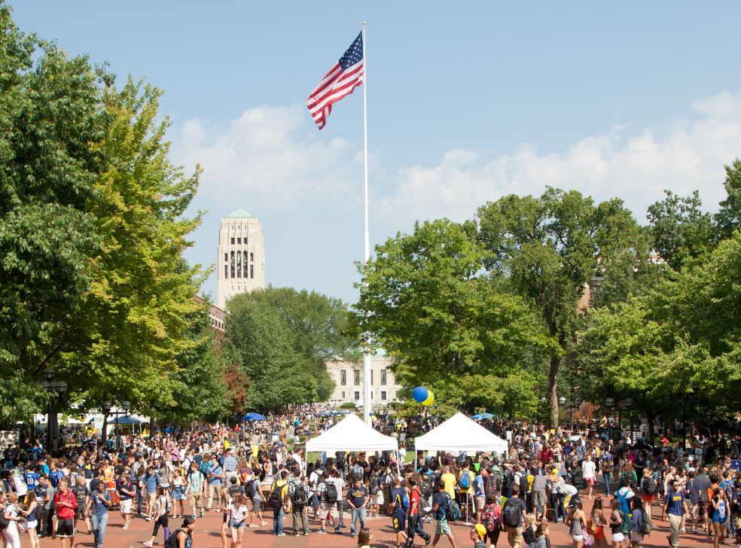
Workforce Intelligence Network
Greater Ann Arbor Region
Health Leaders Council

Slide 2
CURRENT STATE OF AFFAIRS
This data covers Region 9 RPI: Washtenaw, Livingston, Monroe, Lenawee, Jackson, and Hillsdale Counties.
2013
64,766 Region 9 job postings
(688,700 statewide)
9.4% of job postings within the state
Notes:
An overview of what Region 9 looks like and comparison to state.
WIN releases quarterly workforce reports for the WIN region and Region 9 and all individual counties. WIN region reports are available by visiting www.win-semich.org.

Slide 3
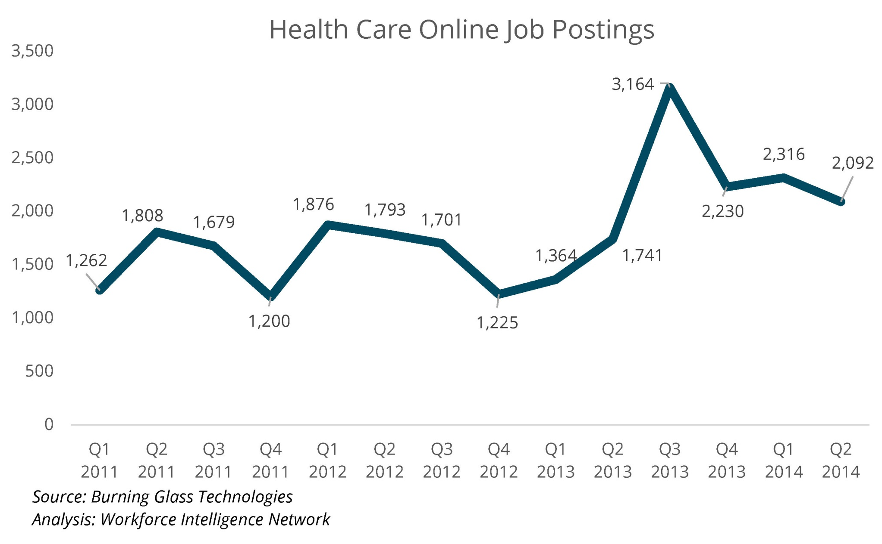
Region 9
All industries across Southeast Michigan and Region 9 experienced a peak in Q3 2013. For the past four quarters, health care jobs postings have been higher that the last 3 years.
Online job posting data according to Burning Glass Labor Insights for Q2 2014 Region 9.
Notes:
This information is organized by occupational clusters rather than by industry.
Online job postings
Explain Burning glass online postings data-this is by occupational cluster, not by industry.
This shows job postings in health care over time.
Health care postings have been higher in the past 4 quarters than over the past three years.
All occupational clusters experienced a peak in Q3 2013. This is not specific to Health care.

Slide 4
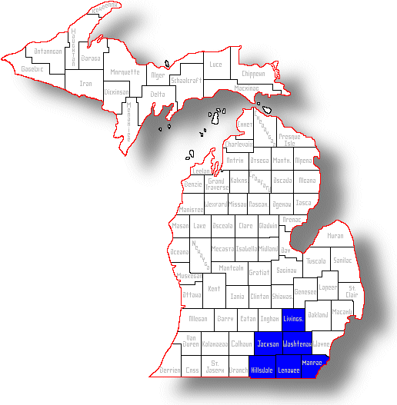
Health care employment
Fast facts:
2013: Health care >46,000 employed
Gender: 80.9% females
Age: 20.9% aged 55+, 45.3% aged 45+
Top jobs-Employment
Registered nurses (10,902)
Nursing assistants(4,993)
Home health aides (3,148)
Data source: EMSI complete employment
Notes:
Educational services might be skewing the data slightly. When Burning Glass sees University in a posting, some of these postings may be put into the educational services bucket.

Slide 5
Top jobs in demand in Region 9 (5/25/2014-8/22/2014)
Source: Burning Glass Technologies
Notes:
Of the top 15 jobs in demand, there are two health care related occupations included.
Can anyone give insight regarding why medical and health services managers are included? Is this a shift? Why?

Slide 6
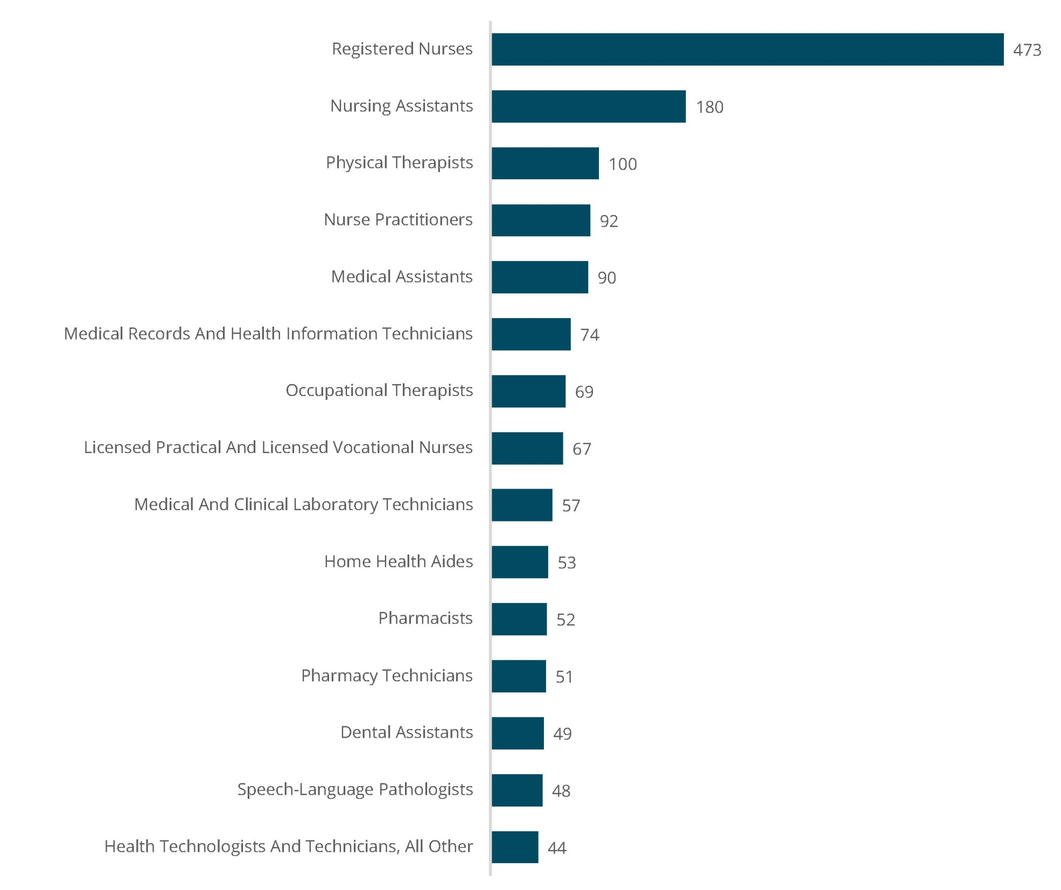
Top 15 Health Care Occupations in Demand- Region 9 Q2 2014
Region 9 job postings, Burning Glass Labor Insights

Slide 7
Region 9 Q2 2014 Health Care Educational Attainment
Top 10 Jobs in Demand according to Burning Glass Labor Insights. Data acquired from Economic Modeling Specialists, Inc. Data is for Q2 2014 Region 9.
Notes:
Call out the 44% need for associate degree registered nurses. How many of them still accept assoc degree RN’s?
Do you see anything different in your requirements for these positions?

Slide 8
Health care demand by county-(Q2 2014)
Source: Burning Glass Technologies
Notes:
Washtenaw county consistently has the highest numbers of postings.

Slide 9
College completions (Selected programs in all regional colleges)
Data source: EMSI
Notes:
Where are you finding talent/hiring from? In the region? Outside the region?

Slide 10
CURRENT STATE OF AFFAIRS (MI data)
Notes:
New graduates cannot possibly fill all of the open positions. Demand is 2.4 times higher (healthcare) than the need.

Slide 11
Want more data?
http://www.win-semich.org
Contact:
Tricia.walding@WIN-SEMICH.ORG
734-552-6710

